Slide 1
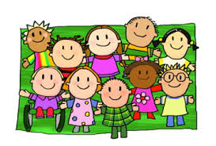
Keeping Our Work Professional, Confidential and Safe

Slide 2
Introductions and Mihi Mihi
Tēnā koutou katoa
Ko ______ tōku maunga (mountains)
Ko ______ tōku awa (river)
Ko ______ tōku iwi (people)
Ko ______ tōku ingoa (surname)
Nō ______ ahau (first name)
Kei _____ tōku kainga (home)
Nō reira, tēnā koutou, tēnā koutou,
tēnā rā tātou katoa

Slide 3
Overview
Knowing the Privacy Act
When professional and private lives overlap
Creating partnerships with teachers, families and whanau
Safety: at-risk students, keeping yourself safe
Keep up the good work

Slide 5
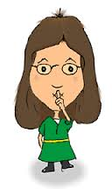
The Privacy Act
Information Privacy Principles
how you collect information
how you store it, and what procedures you have to protect its security
the need to keep it complete, up to date and accurate before you use it
how long you can keep it
what you can use it for
when you can disclose it
allowing the person who is the subject of the information to access it
correcting it if it is wrong.
Notes:
Almost everyone holding personal information about others - have to comply with the Privacy Act.

Slide 6
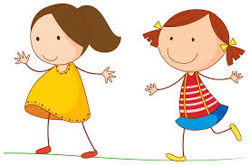
Discuss…
What does confidentiality mean?
Does confidentiality mean different things in your personal and professional lives? If yes, in what ways?
Are there clear guidelines and expectations about confidentiality at your school?
Do you know where to find out about these?

Slide 7
Activity
Notes:
Handout pages 19-20 from workbook

Slide 8
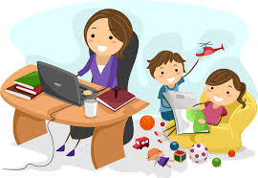
When professional and private lives overlap:
When people’s professional and private lives overlap it can be a good thing
Sometimes it can be tricky for teachers and teachers’ aides when they live in the communities they work in: it’s not always clear whether they’re in their professional role, talking as a friend or as a community member.
Notes:
it’s generally beneficial for teachers/ TAs to know a bit about their students’ backgrounds
The connections you make within and outside the school may make conflicting demands on you professionally.

Slide 9
family/whanau
parent
community
church
home
neighbour
school
family member
aunty/uncle
sibling
niece
carer
sport club
kapahaka
choir
art group
carer
councillor
volunteer
carer
teacher’s aide
bilingual tutor
bus driver

Slide 10
A New Kind Of Hazard….
Notes:
Social media has its own set of issues
Jocelyn share example of Facebook gone bad

Slide 11
Discussion: juggling all the roles
Notes:
Refer to handouts PAGE 19-20 3 column discussion

Slide 12
Tips and Reminders:
Hold discussions about students in private and out of earshot of other students
Be clear about which staff members need to know about the student and share information only with those staff members
If you are talking about your job out of school, do not discuss specific students or school issues (if in doubt, say nothing)
Know who your GO TO person is in the school to discuss confidentiality

Slide 13
Creating Partnerships
All conversations with families and whanau need to show respect for the student and their privacy
Discussions should demonstrate that you value the family/whanau’s input
Initial talks should include an agreement of the best TIME, PLACE and METHOD for sharing information
Always ask yourself: is this a conversation you should be having? ….. or is it more appropriate for the teacher to have this discussion?

Slide 14
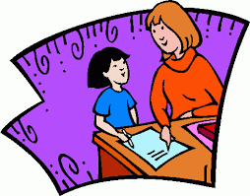
Student Safety
your school will have its own policies and guidelines for student disclosures.
It’s important that all teachers and teachers’ aides are aware of the appropriate protocols to follow should a student disclose information or if the teacher or teacher’s aide becomes concerned about the student’s overall wellbeing or risk of harm.
if you believe a student is at risk, it is your responsibility to discuss your concerns with Senior Management

Slide 15
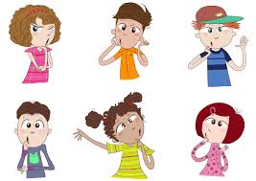
Your Safety
ACTIVITY
Discuss in a small group ALL the possible situations that could affect your personal safety.

Slide 16
if you provide personal and physical care for students or work with a student one to one, it’s essential to follow your school’s health and safety policy and procedures and receive appropriate training to keep yourself safe.
as students get older, these considerations become more important. (for example, in the senior school, it may be safer for a teacher’s aide to work with a group rather than one to one
or
maybe the role should be done by a teacher’s aide of the same gender as the student.

Slide 17
Keep Up The Good Work

Slide 18
Meeting regularly with teachers and SENCO helps build and maintain your professional relationship.
As well as providing an opportunity to plan, a regular meeting time lets you reflect together.
It’s important to talk about and celebrate what’s going well and discuss and problem-solve anything that’s not going so well.

